Slide 1
Serverless Pros and Cons

Slide 2
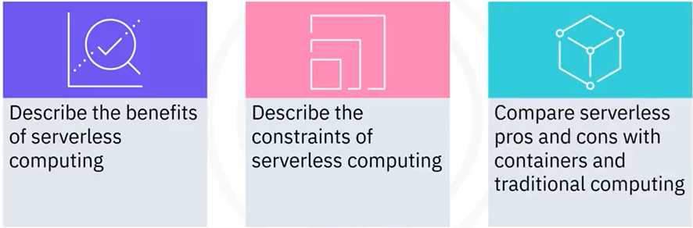
What you will learn

Slide 3
Serverless computing pros and cons
• In traditional computing, development and operations teams set up and
maintain infrastructure
• Setup and deployment are time-consuming, complex, and expensive
• Arrival of cloud, containers, and serverless computing means developers
can focus on writing high-quality code
• Developers can build and run applications in milliseconds without worrying
about infrastructure, scalability, and fault tolerance
• Challenges include vendor lock-in, 3rd-party dependencies, and networking

Slide 4
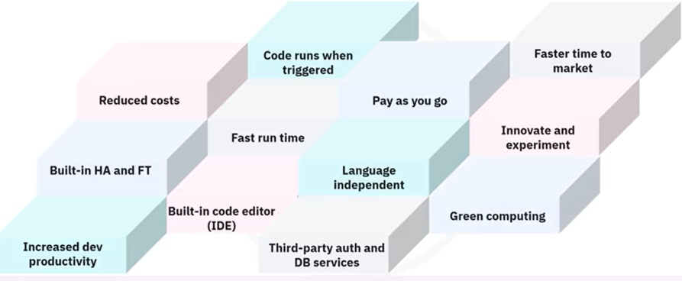
Serverless computing benefits

Slide 5
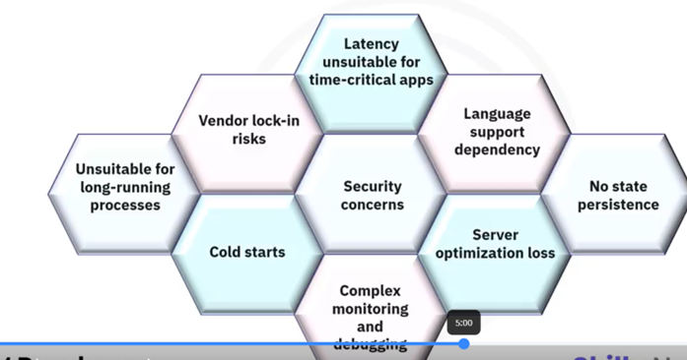
Serverless computing constraints

Slide 6
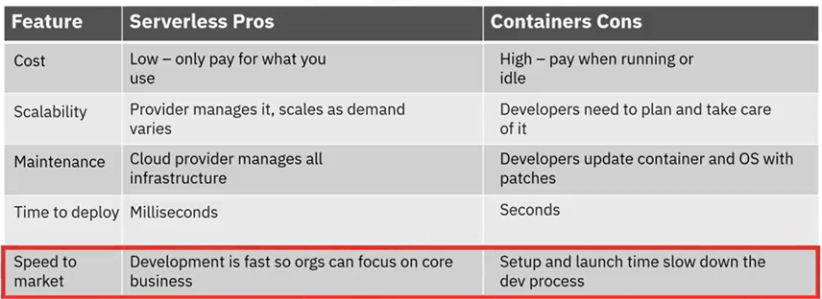
Serverless versus containers
Pros of serverless and cons of containers

Slide 7
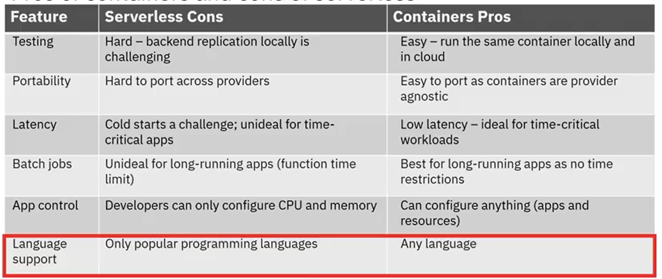
Serverless versus containers
Pros of containers and cons of serverless

Slide 8
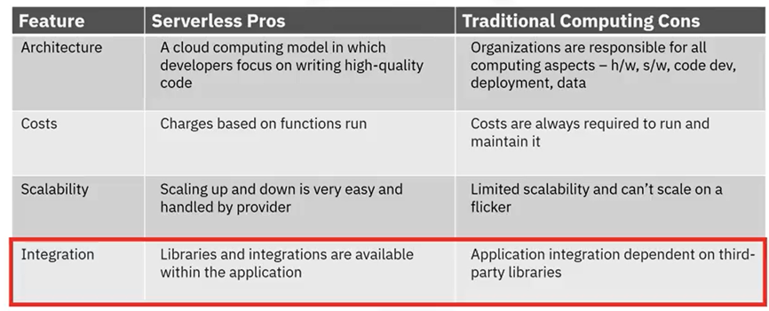
Serverless versus traditional
Pros of serverless and cons of traditional

Slide 9
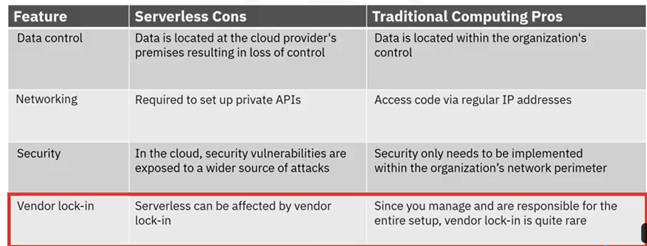
Serverless versus traditional
Pros of traditional and cons of serverless

Slide 10
Recap
In this video, you learned that:
• With traditional computing, you set up and maintain the infrastructure
• Arrival of serverless computing means development teams can focus on writing
high-quality code
• Serverless offers several benefits such as built-in, high availability and fault
tolerance, faster function run times, and pay-per-request billing
• Serverless computing has several constraints, including unacceptable latency
for time-critical apps, complex monitoring and debugging, and no state
persistence
• Serverless and containers work best together in a hybrid solution
• Serverless and traditional computing have pros and cons

